Slide 1
Sistem Testing Technique

Slide 2
Validation dan Verification (V&V)
“Validation are we building the product right”
“Verification are we building the right product”
Validation (Product Oriented)
  Validation is concerned with whether the right functions of the program have been properly implemented, and that this function will properly produce the correct output given some input value.
Verification (Process Oriented)
  Verification involves checking to see whether the program conforms to specification. I.e the right tools and methods have been employed. Thus it focuses on process correctness.

Slide 3
Testing dari low-level ke high level (Tahapan Testing)
Sistem tidak diujikan sebagai suatu unit tunggal, kecuali untuk program yang kecil.
Systems yang Besar terdiri dari sub-systems, dimana masing2 sub-system terdiri dari modules yang dibentuk oleh procedures and functions.
Proses testing dilakukan dalam beberapa langkah sehingga diproses secara incrementally dalam proses implementasi sistem.

Slide 4
Testing Technique
Component testing | Unit Testing | Verification (Process Oriented) | White Box Testing Techniques (Tests that are derived from knowledge of the program’s structure and implementation)
 | Module Testing
Integrated testing | Sub-System Testing
 | System Testing
User testing | Acceptance Testing | Validation (Product Oriented) | Black Box Testing Techniques (Tests are derived from the program specification)

Slide 5
Tahapan Proses Pengujian
Unit testing
Module Testing
Sub-system Testing
System Testing
Acceptance Testing
Unit
Testing
Module
Testing
Sub-system
Testing
System
Testing
Acceptance
Testing
User
Testing
Component Testing
Integration Testing

Slide 6
Unit Testing
Individual components diujikan untuk meyakini bahwa akan beroperasi secara benar. Setiap komponen diujikan secara terpisah, tanpa komponen sistem yang lainnya
  Code Coverage
  Path Testing

Slide 7
Path Testing
Tujuannya meyakinkan bahwa himpunan test case akan menguji setiap path pada suatu program paling sedikit satu kali.
Titik awal untuk path testing adalah suatu program flow graph yang menunjukkan node-node yang menyatakan program decisions (mis.: if-then-else condition) dan busur menyatakan alur kontrol
Statements dengan conditions adalah node-node dalam flow graf.

Slide 8
Program flow graphs
Menggambarkan alur kontrol. Setiap cabang ditunjukkan oleh path yg terpisah dan loop ditunjukkan oleh arrows looping kembali ke loop kondisi node.
Digunakan sebagai basis untuk menghitung cyclomatic complexity
Cyclomatic complexity = Jumlah edges – Jumlah Node +2
Cyclomatic complexity menyatakan jumlah test untuk menguji control statements

Slide 9
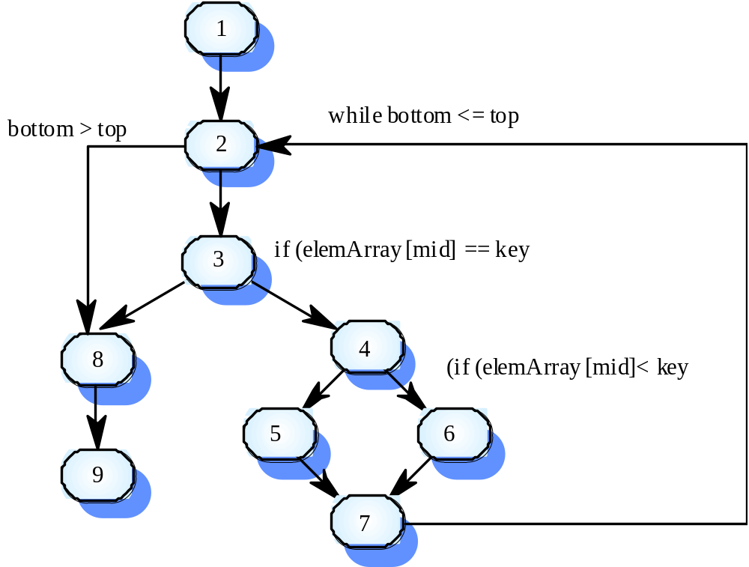
Contoh: Binary Search

Slide 10
Path untuk Pengujian Data
1, 2, 3, 8, 9
1, 2, 3, 4, 6, 7, 2
1, 2, 3, 4, 5, 7, 2
1, 2, 3, 4, 6, 7, 2, 8, 9
Test cases harus ditentukan sehingga semua path tsb tereksekusi.

Slide 11
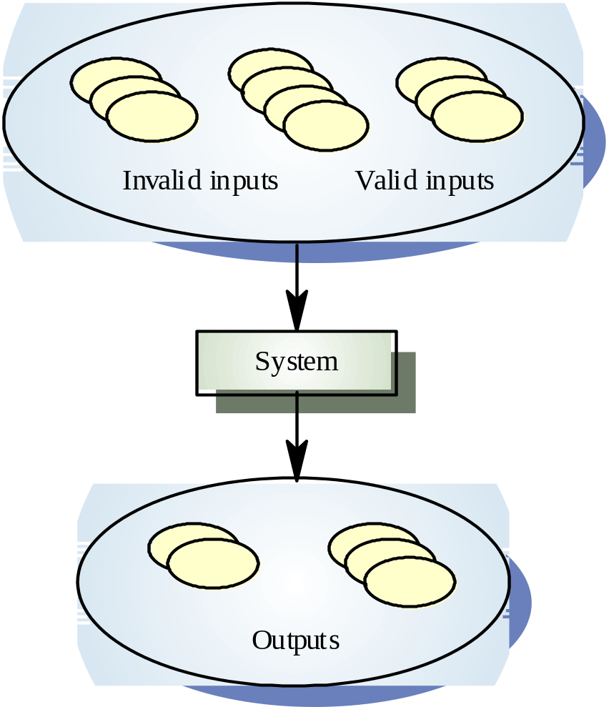
Equivalence Partitioning
Input data of a program is divided into different categories so that test cases can be developed for each category of input data.
The goal is to come out with test cases so that errors are uncovered and test cases can be carried out more efficiently.

Slide 12
Module testing
A module is a collection of dependent components such as an object class, an abstract data type or some looser collection of procedures and functions. A module encapsulates related components so it can be tested without other system modules.

Slide 13
Sub-system testing: (Integration Testing) (Design Oriented)
Involves testing collections of modules, which have been integrated into sub-systems.
Most common problems, which arise in large software systems, are sub-systems interface mismatches.
Concentrate on the detection of interface errors by rigorously exercising these interfaces.

Slide 14
Integration Testing
Top-down testing
  Berawal dari level-atas system dan terintegrasi dengan mengganti masing-masing komponen secara top-down dengan suatu stub (program pendek yg mengenerate input ke sub-system yg diuji).
Bottom-up testing
  Integrasi components di level hingga sistem lengkap sudah teruji.
Pada prakteknya, kebanyakan test integrasi menggunakan kombinasi kedua strategi pengujian tsb.

Slide 15
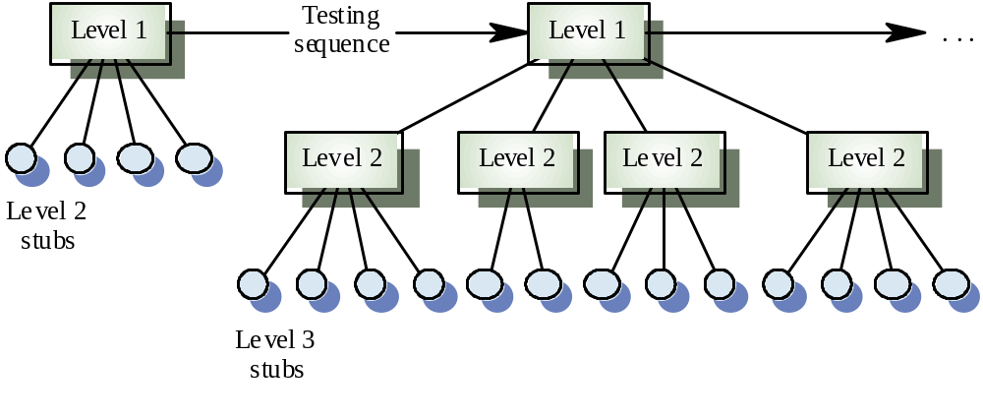
Top Down Testing

Slide 16
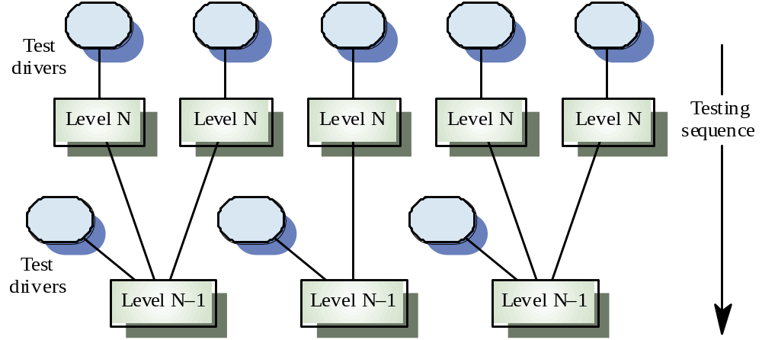
Bottom Up Testing

Slide 17
System testing
The sub-systems are integrated to make up the entire system.
Concerned with finding errors that result from unanticipated interactions between sub-systems and system components.
Concerned with validating that the system meets its functional and non-functional requirements.

Slide 18
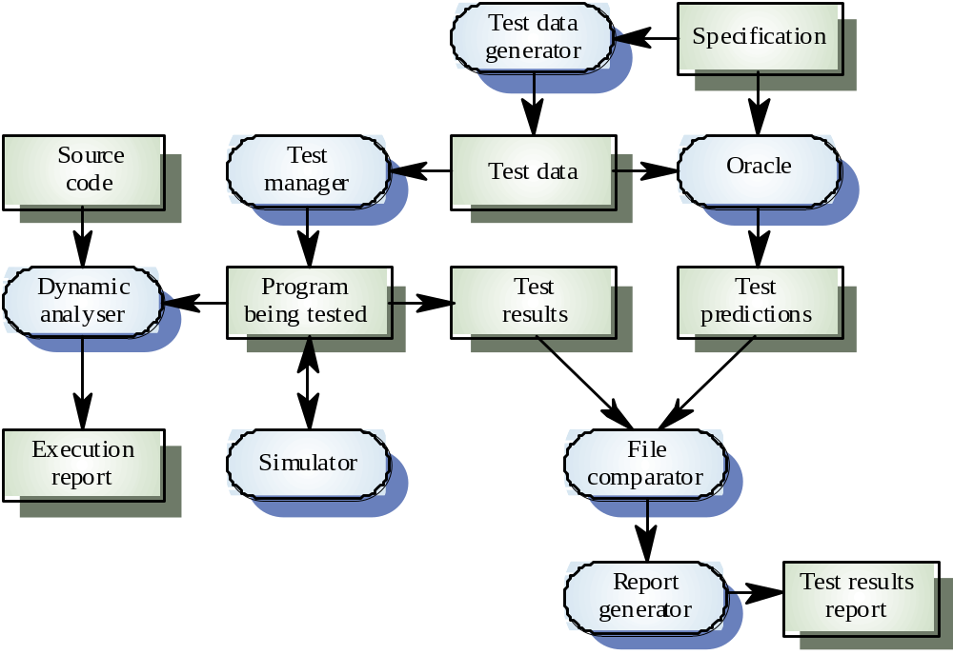
Testing Workbench

Slide 19
Object-oriented testing
Components yang diuji adalah class object yang diinstantiate ke object.
Lebih besar dibandingkan pengujian sebuah function sehingga pendekatan white-box testing perlu diperluas.
Tidak jelasnya ‘top’ suatu system untuk top-down integration dan testing

Slide 20
Testing levels
Testing operations pada objects
Testing object classes
Testing clusters cooperating objects
Testing OO system secara lengkap

Slide 21
Object class testing
Complete test yang menguji class melibatkan
  Testing semua operations suatu object
  Setting dan interrogating semua attribute object
  Menguji object untuk semua state(keadaan) yg mungkin
Inheritance akan mengakibatkan sulitnya perancangan object class tests seperti information yg diuji sulit dilokalisasi.

Slide 22
Acceptance testing
Final stage in the testing process before the system is accepted for operational use.
Test with data supplied by the system client rather than simulated test data.
May reveal errors and omissions in the systems requirements definition( user – oriented) because real data exercises the system in different ways from the test data.
May reveal requirement problems where the system facilities do not really meet the users needs (functional) or the system performance (non-functional) is unacceptable.

Slide 23
Acceptance Test (2)
Sometimes called alpha testing. The alpha testing process continues until the system developer and the client agrees that the delivered system is an acceptable implementation of the system requirements.
When a system is to be marketed as a software product, a testing process called beta testing is often used.
Beta testing involves delivering a system to a number of potential customers who agree to use that system.

Slide 24
Network Security Testing
Test the network parameters and configurations (firewall, web server, mail server, etc)
Test the network media transmission,
Test the connections for WAN/MAN/LAN,
Test the network provider performance,

